Slide 1
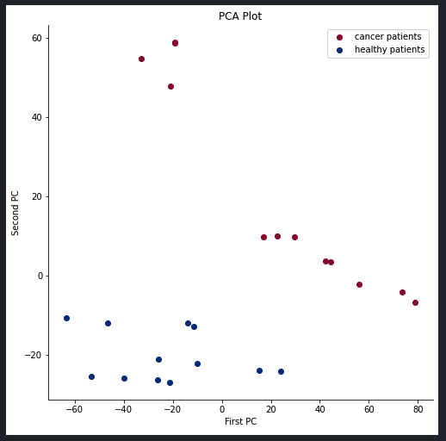
Non-Batch Corrected Data

Slide 2
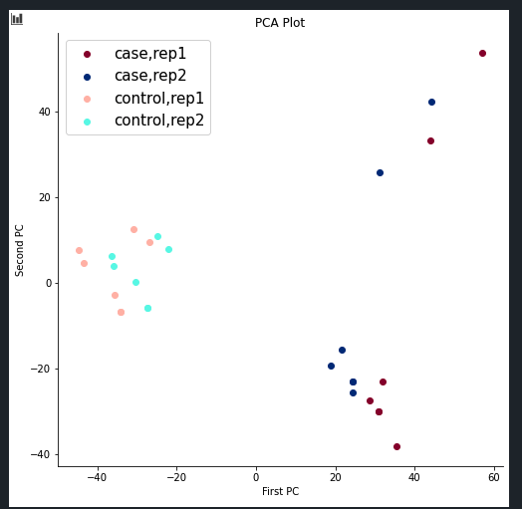
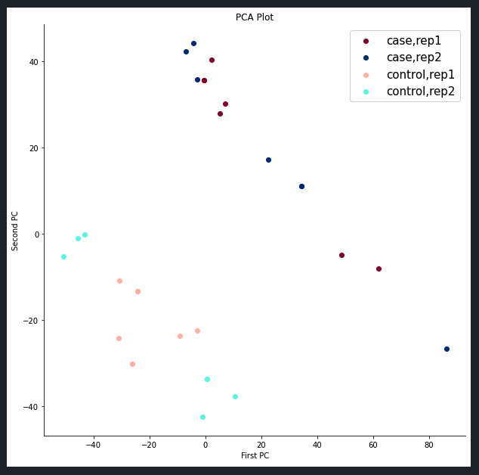
Non-Class Specific Batch Correction
Class Specific Batch Correction

Slide 3
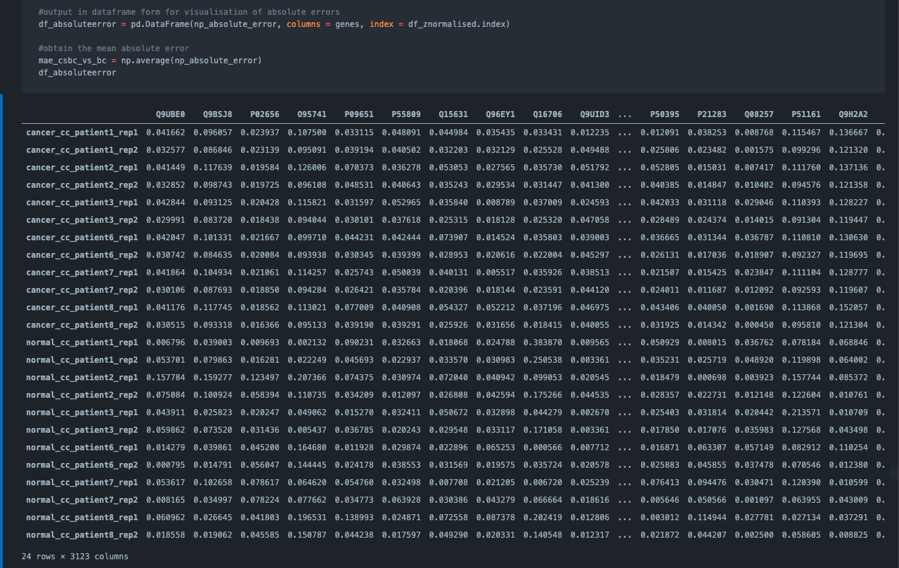
Mean Absolute Error (Class Specific Batch Corrected Data)
Average Error = 0.05702117420523973

Slide 4
Non-Batch Corrected
Before MTC: 1959
After MTC: 505
Enriched: 83
Batch Corrected
Before MTC: 1770
After MTC: 486
Enriched: 69

Slide 5
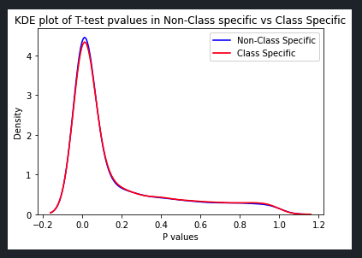
P value distribution
Post-MTC p-value distribution of the protein genes
0.05702117420523973

Slide 6
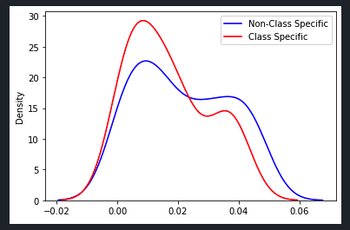
P value distribution
Enriched p-value distribution of the protein genes

